Slide 1
No SQL Database

Slide 2
NoSql Database
NoSQL databases also known as "not only SQL" are non tabular, and store data differently than relational tables.
NoSQL databases come in a variety of types based on their data model.
The main types are document, key-value, wide-column, and graph.
They provide flexible schemas and scale easily with large amounts of data and high user loads.

Slide 3
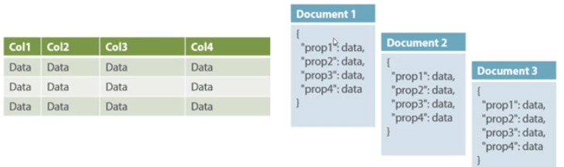
Document databases
Store data in documents similar to JSON (JavaScript Object Notation) objects.
Each document contains pairs of fields and values.
The values can typically be a variety of types including things like strings, numbers, booleans, arrays, or objects, and their structures typically align with objects developers are working with in code.
MongoDB is consistently ranked as the world’s most popular NoSQL database according to DB-engines and is an example of a document database.

Slide 4
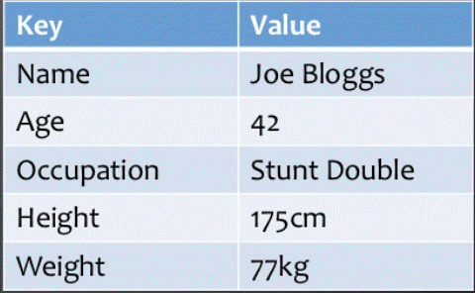
Key-value databases
are a simpler type of database where each item contains keys and values
A value can typically only be retrieved by referencing its key.
Key-value databases are great for use cases where you need to store large amounts of data but you don’t need to perform complex queries to retrieve it.
Common use cases include storing user preferences or caching. Redis and DynanoDB are popular key-value databases

Slide 5
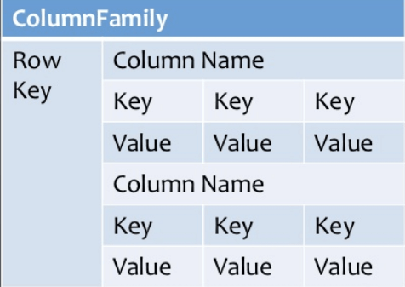
Wide-column stores
Store data in tables, rows, and dynamic columns
Wide-column stores provide a lot of flexibility over relational databases because each row is not required to have the same columns
Many consider wide-column stores to be two-dimensional key-value databases.
Wide-column stores are great for when you need to store large amounts of data and you can predict what your query patterns will be.
Wide-column stores are commonly used for storing Internet of Things data and user profile data
Cassandra and HBase are two of the most popular wide-column stores.

Slide 6
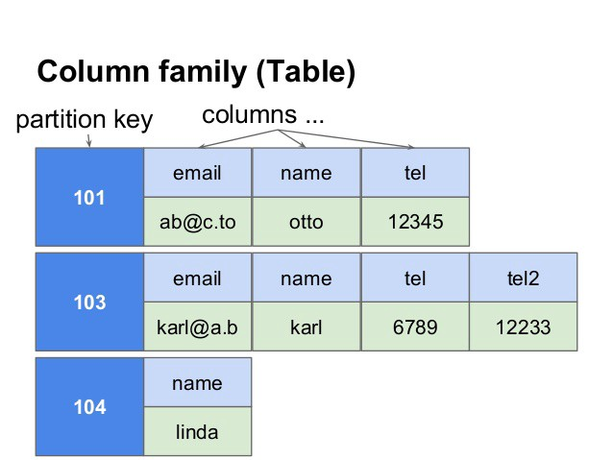

Slide 7
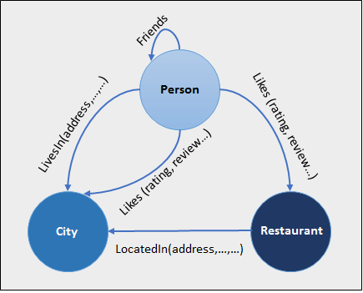
Graph databases
Store data in nodes and edges
Nodes typically store information about people, places, and things while edges store information about the relationships between the nodes.
Graph databases excel in use cases where you need to traverse relationships to look for patterns such as social networks, fraud detection, and recommendation engines.
Neo4j and JanusGraph are examples of graph databases.

Slide 8
What is the CAP Theorem?
CAP theorem is also called brewer's theorem
It states that is impossible for a distributed data store to offer more than two out of three guarantees
1. Consistency
2. Availability
3. Partition Tolerance

Slide 9
1. Consistency:
The data should remain consistent even after the execution of an operation.
This means once data is written, any future read request should contain that data.
For example, after updating the order status, all the clients should be able to see the same data.

Slide 10
2. Availability:
The database should always be available and responsive. It should not have any downtime.

Slide 11
3. Partition Tolerance:
Partition Tolerance means that the system should continue to function even if the communication among the servers is not stable.
For example, the servers can be partitioned into multiple groups which may not communicate with each other.
Here, if part of the database is unavailable, other parts are always unaffected.

Slide 12
SQL Follows ACID
Atomicity — An “all or nothing” approach. If any statement in the transaction fails, the entire transaction is rolled back.
Consistency — The transaction must meet all protocols defined by the system. No half completed transactions.
Isolation — No transaction has access to any other transaction that is in an intermediate or unfinished state. Each transaction is independent.
Durability — Ensures that once a transaction commits to the database, it is preserved through the use of backups and transaction logs.
The ACID properties aren’t flexible.
For example, RDBMS follows Normalization or a single point of truth concept. For every change you make, you should ensure strict ACID properties. The entity integrity and referential integrity rules also apply

Slide 13
NO SQL Follows: BASE
‌NoSQL relies upon a softer model known as the BASE model.
Basically Available: Guarantees the availability of the data . There will be a response to any request (can be failure too).
Soft state: The state of the system could change over time.
Eventual consistency: The system will eventually become consistent once it stops receiving input.
NoSQL databases give up the A, C and/or D requirements, and in return they improve scalability.

Slide 14
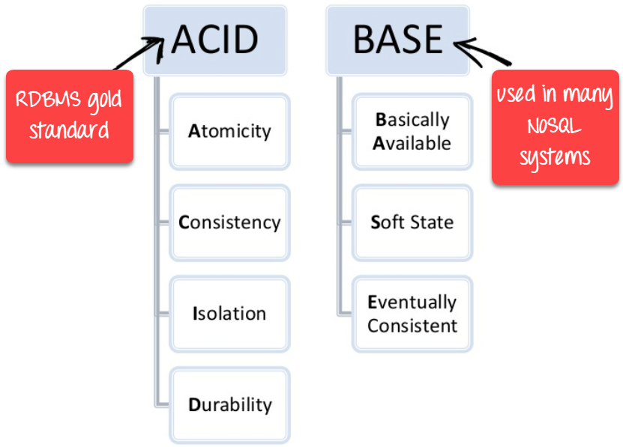

Slide 15
Advantages of NoSQL
Can be used as Primary or Analytic Data Source
Big Data Capability
No Single Point of Failure
Easy Replication
No Need for Separate Caching Layer
It provides fast performance and horizontal scalability.
Can handle structured, semi-structured, and unstructured data with equal effect
Object-oriented programming which is easy to use and flexible
NoSQL databases don't need a dedicated high-performance server
Support Key Developer Languages and Platforms
Simple to implement than using RDBMS
It can serve as the primary data source for online applications.
Handles big data which manages data velocity, variety, volume, and complexity
Excels at distributed database and multi-data center operations
Eliminates the need for a specific caching layer to store data
Offers a flexible schema design which can easily be altered without downtime or service disruption

Slide 16
Disadvantages of NoSQL
No standardization rules
Limited query capabilities
RDBMS databases and tools are comparatively mature
It does not offer any traditional database capabilities, like consistency when multiple transactions are performed simultaneously.
When the volume of data increases it is difficult to maintain unique values as keys become difficult
Doesn't work as well with relational data
The learning curve is stiff for new developers
Open source options so not so popular for enterprises.

Slide 17
MongoDB
MongoDB is an object-oriented, simple, dynamic, and scalable NoSQL database.
It is based on the NoSQL document store model.
The data objects are stored as separate documents inside a collection instead of storing the data into the columns and rows of a traditional relational database.
MongoDB supports JSON query language along with SQL but RDBMS supports SQL query language only.
MongoDB is almost 100 times faster than traditional database system like RDBMS, which is slower in comparison with the NoSQL databases

Slide 18
References
https://www.mongodb.com/scale/types-of-nosql-databases
https://dzone.com/articles/why-mongodb
https://www.guru99.com/nosql-tutorial.html

